Slide 1
Diwali Sales Analysis
Jatin Dolas
Data Analyst

Slide 2
Agenda
Introduction
Data Processing
Data Visualization
Insights
Conclusion

Slide 3
Introduction
In this presentation, we shed light on the post-Diwali scenario where businesses reflect on their performance and assess the impact of their Diwali sales strategies. Diwali, the Festival of Lights, is a time of great significance for businesses, and analyzing the results of your efforts is crucial for future success. We will explore the power of data, dissect the key metrics, and share insights on how to conduct a comprehensive Diwali sales analysis. Let's embark on this journey to uncover the brilliance of data-driven decision-making.

Slide 4
Data Processing
Processing Data : Workflow Steps
I used the Python tool its libraries to process the data like Pandas, NumPy, Matplotlib, and seaborn.
Dropped all null values and removed columns like ‘Status’ and ‘unnamed’ from the data frame.
Changed the data type of ‘Amount’ column from int64 to int32.
Renamed the column name of ‘Zone’ into ‘Area’.

Slide 5

Data Visualization
Graphical Representations in upcoming slides.

Slide 6
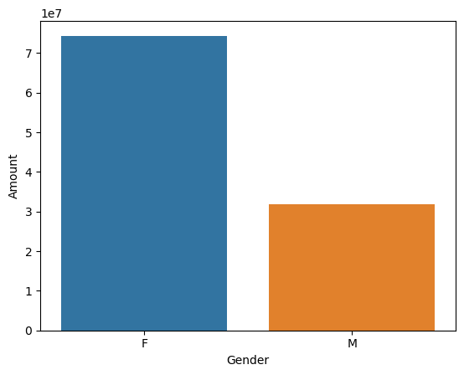
Gender
Notes:
From above graphs we can see that most of the buyers are females and even the purchasing power of females are greater than men.

Slide 7
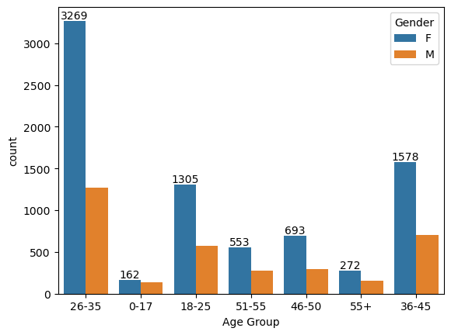
Age Group
Notes:
From above graphs we can see that most of the buyers are of age group between 26-35 years female.

Slide 8
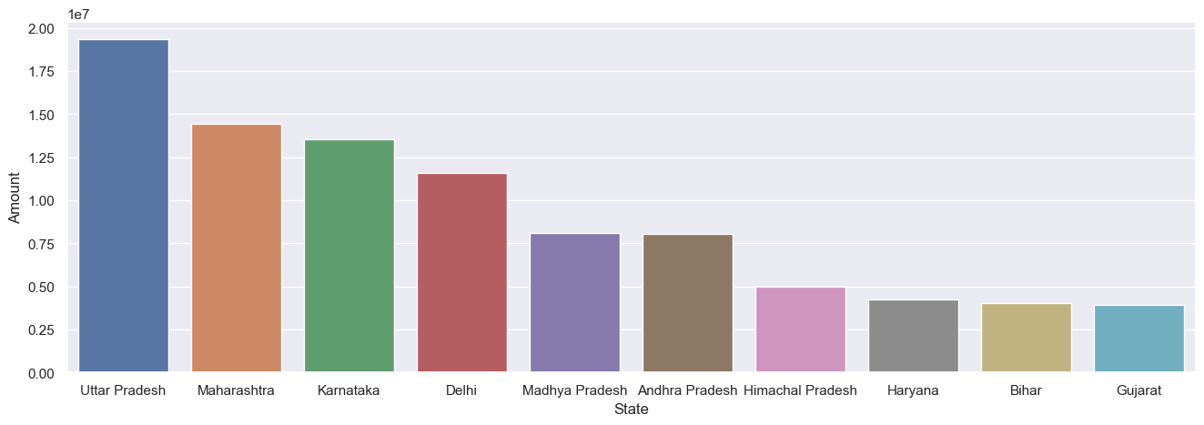
State
Notes:
From above graphs we can see that most of the orders & total sales/amount are from Uttar Pradesh, Maharashtra and Karnataka, respectively.

Slide 9
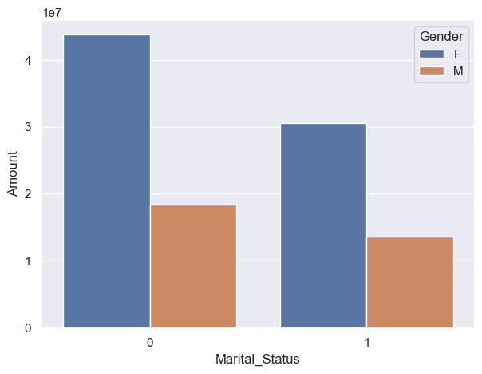
Marital Status
Notes:
From above graphs we can see that most of the buyers are married (women) and they have high purchasing power.

Slide 10
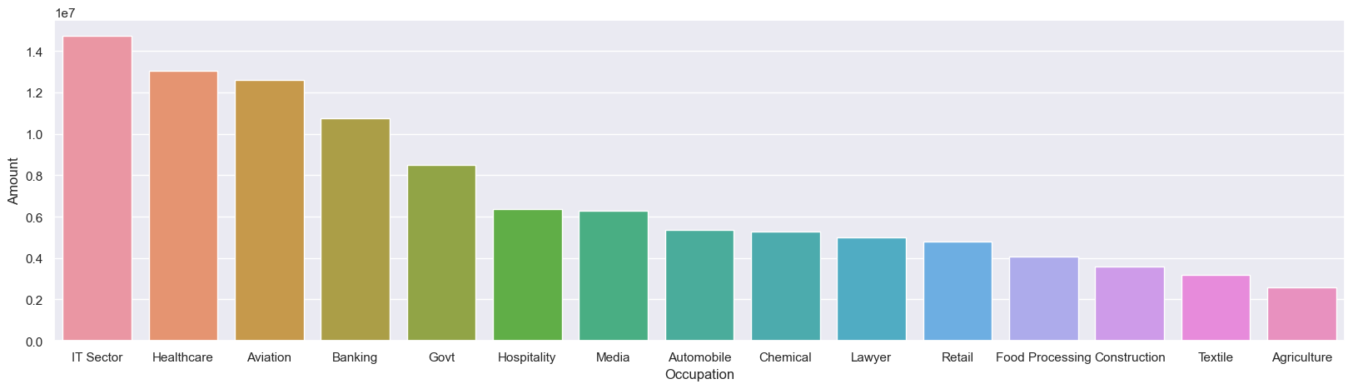
Occupation
Notes:
From above graphs we can see that most of the buyers are working in IT, Healthcare and Aviation sector.

Slide 11
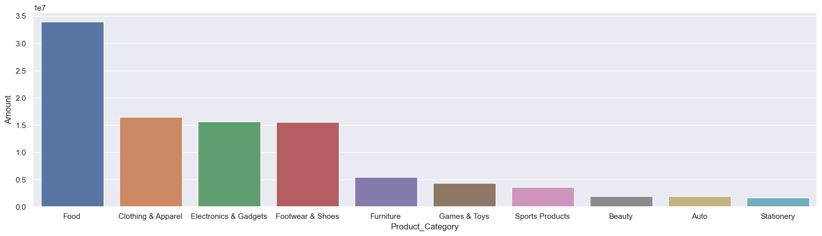
Product Category
Notes:
From above graphs we can see that most of the sold products are from Food, Clothing and Electronics category.

Slide 12
Insights
Gender – Most of the buyers are females and even the purchasing power of females are greater than men.
Age Group – Most of the buyers are of age group between 26-35 years female.
State – Most of the orders & total sales/amount are from Uttar Pradesh, Maharashtra and Karnataka, respectively.
Notes:
Marital Status – Most of the buyers are married (women) and they have high purchasing power.
Occupation – Most of the buyers are working in IT, Healthcare and Aviation sector.
Product Category – Most of the sold products are from Food, Clothing and Electronics category.

Slide 13
Insights
Marital Status – Most of the buyers are married (women) and they have high purchasing power.
Occupation – Most of the buyers are working in IT, Healthcare and Aviation sector.
Product Category – Most of the sold products are from Food, Clothing and Electronics category.

Slide 14
Conclusion
Most of the Married women lies between 26-35 years of age group from UP, Maharashtra and Karnataka region working in IT, Healthcare and Aviation sector are more likely to buy products from Food, Clothing and Electronics category.

Slide 15
Thank you
Jatin Dolas​
jatindolas18@gmail.com

